Slide 1

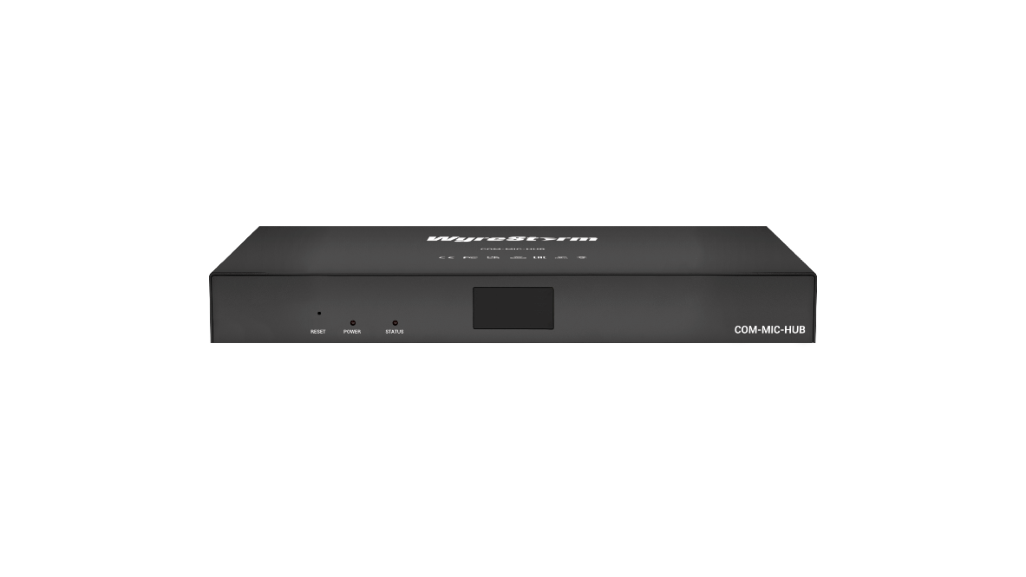
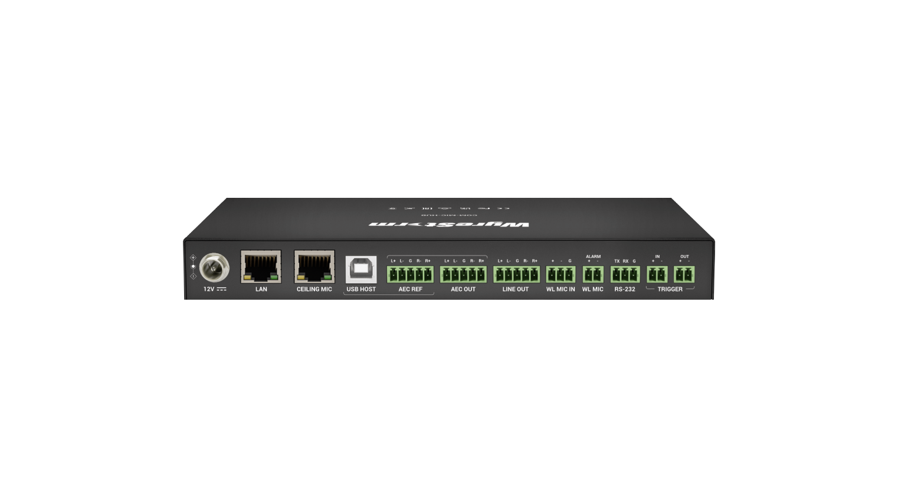

COM-MIC-HUB
Product Guide
Professional Microphone Hub
COM-MIC-HUB
Wired and wireless mic system
Notes:
1. 更新封面，不需要展示产品；

Slide 2

Contents
Product Overview & Main Features
Why Choose Us?
Interface & Specifications
Typical Connection & Applications
Quick Installation Guide & Web UI Introduction
Q & A Session
Powerful · Reliable · Simple

Slide 3
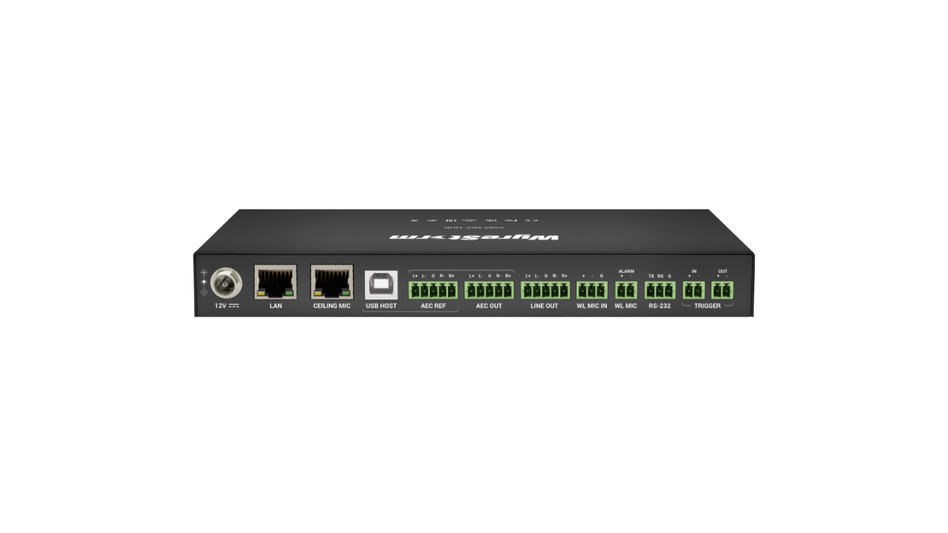
Product Overview
Professional Microphone Hub
The COM-MIC-HUB is a central audio processing device designed for extended sound pickup in classrooms, conference rooms, and similar environments. It seamlessly integrates with APO-SKY-MIC ceiling microphones, third-party wireless microphones, as well as PCs and amplifiers, ensuring an optimal hybrid meeting and teaching experience. This versatile system supports both wired and wireless microphones, making it ideal for hybrid scenarios that require remote voice conferencing and local amplification.
Additionally, it features an alarm function compatible with external emergency systems, while its user-friendly Web UI enables effortless setup and configuration. Perfect for any setting requiring simultaneous audio pickup and amplification, the COM-MIC-HUB enhances sound clarity and convenience in professional and educational environments.
Powerful · Reliable · Simple

Slide 4








Main Features
Wireless Mic Access
Provide wireless MIC IN interface for local amplification and remote teaching.
Optional Connection Methods to Hosts
Provides two optional ways to connect to a PC or other host device for remote conference and teaching: analog audio I/O and USB audio.
Ceiling Mic Connection and Cascades
Supports Ceiling Mic cable connection and can cascade it up to 5 devices. It’s ideal for remote conference in large meeting room.
Ability to Mix and Route Audio Signals
Supports to mix multiple audio inputs and route them to different outputs for local amplification or remote conference.
Built-in Audio DSP
Supports AEC, AGC and ANS to provide a fully immersive audio experience for all participants.
Ducking Function
Lower the background sound so that the current speaker's voice can be heard clearly.
User-Friendly Web UI
Provides a very user-friendly and intuitive WEB UI for setup and control as well as firmware upgrade.
Emergency Alarm Function
Provides interfaces to connect the external emergency system and send the alarm message via three optional message output methods.
Powerful · Reliable · Simple

Slide 5
Why Choose Us: 1. Wired and Wireless Mic system for hybrid application
A central audio processing device for extended sound pickup system for remote voice conferencing and local amplification.
Various Microphones Compatibility
Expand Your Reach
Support both wired and wireless microphones, allowing customers to flexibly choose the type of microphone based on project requirements.
Add on the APO-SKY-MIC ceiling microphone for expanded pickup range in your meeting space. This microphone features a 360°-degree pick-up angle at a distance up to 3m. Cascade up to 5 mics and ensure even the largest rooms are fully covered.
Audio Signal Routing
Route multiple inputs and outputs to meet the needs of meeting rooms or classrooms, enabling both local amplification and remote conferencing.
Powerful · Reliable · Simple

Slide 6
Why Choose Us: 2. Enhanced Application Features & Professional centralized Control
Our system offers advanced audio processing, versatile connectivity, and centralized control for a seamless and efficient hybrid experience.
Ability to Audio Processing
External Emergency System Access
Provides the ability to AEC, AGC, ANS, and can mix the multiple inputs to output. Besides, it has ducking function that offers a perfect conference or teaching experience for end-users.
Provides two alarm in and three alarm out interfaces to connect external emergency or safety system, meeting the needs of various actual application scenarios.
Connecting Various Hosts Option
Centralized Control
Offer 1x USB Host, 1x analog audio input AEC Ref, and 1x analog audio output AEC OUT to connect PCs or other host devices, providing enhanced connectivity for remote conferences.
Provides a user-friendly Web UI and API for setup and control as well as firmware upgrade, greatly enhance the efficiency of hybrid meetings.
Powerful · Reliable · Simple

Slide 7
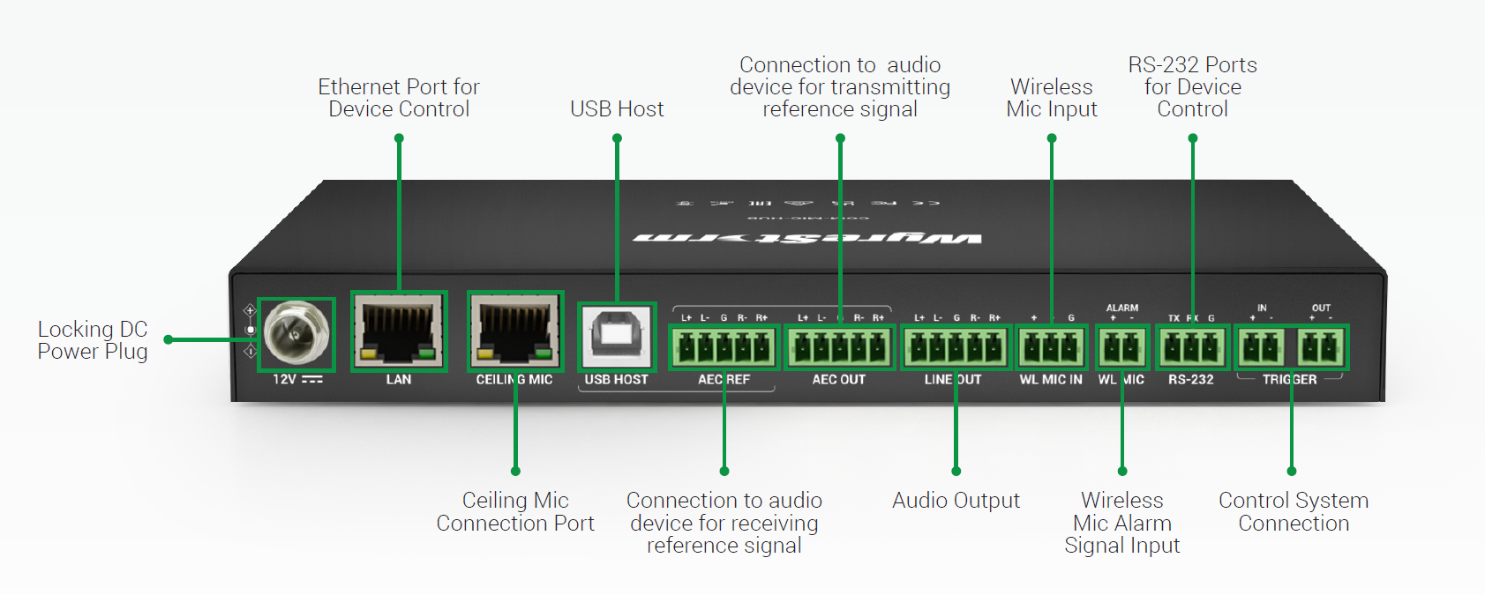
Interface of the Product
Featuring:
Front Panel
Ceiling Mic Connectivity：
Simplifies setup by connecting and powering multiple ceiling microphones with a single cable.
AEC Audio Processing：
Delivers clear communication with seamless audio input and output processing.
Emergency Integration：
Supports safety systems with RS-232 and trigger input/output for messaging and control.
OLED Display
the information of operation
Rear Panel
Powerful · Reliable · Simple

Slide 8
Specifications & Packing List
Main Specifications
USB-B HOST | 1x, USB-B(USB2.0)
Input Ceiling Mic | 1x, RJ45( Support up to 5 levels of APO-SKY-MIC cascade)
AEC REF | 1x, 5 pin Phoenix(Balance stereo input)
Input Wireless MIC | 1x, 3 pin Phoenix(Balance mono input)
WL MIC (Alarm) | 1x, 2 pin Phoenix(Alarm signal)
AEC OUT | 1x, 5 pin Phoenix(Balance stereo out)
LINE OUT | 1x, 5 pin Phoenix (Balance stereo out)
Communication and Control | Ethernet: 1x, RJ45 RS-232: 1x, 3 pin Phoenix Trigger IN: 1x, 2 pin Phoenix Trigger OUT: 1x, 2 pin Phoenix
Audio Algorithm | AEC, AGC, ANS
Control Method | LAN (Telnet API & Web UI)
Power Supply | DC 12V/2A PSU
Power Consumption (max) | 10.2W
Dimensions (W x H x D) | 215mm x 25mm x 120mm/8.46” x 0.98” x 4.72”
What’s in the Box?
1 x DC 12V Power Adapter (with US, UK, EU & AU Pins)
4 x 5-Pin 3.5mm Phoenix Male Connector
3 x 2-Pin 3.5mm Phoenix Male Connectors
1 x 3-Pin 3.5mm Phoenix Male Connectors
4 x Mounting Brackets
4 x Mounting Screws (M2.5*L5)
Powerful · Reliable · Simple

Slide 9
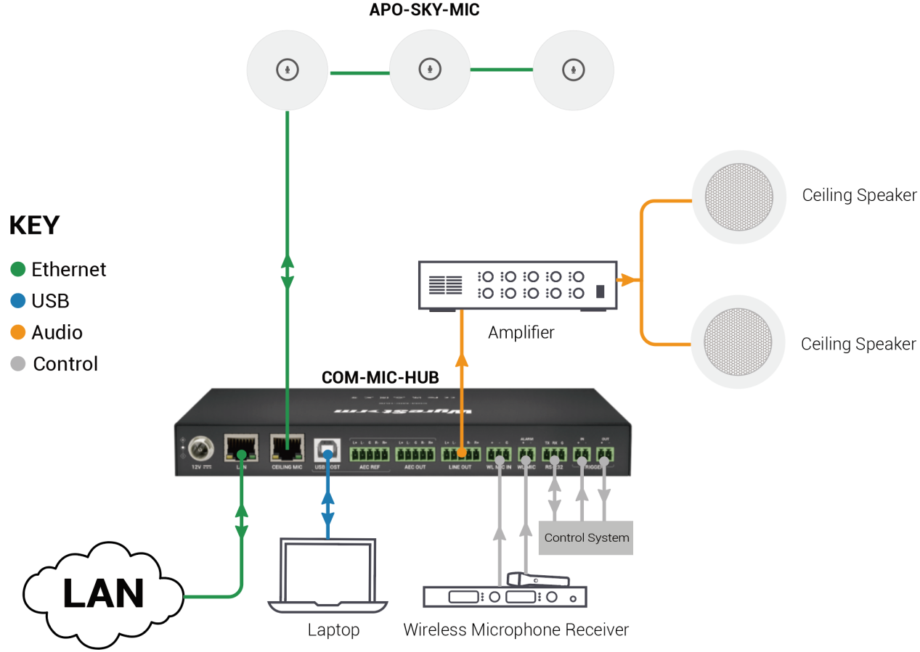
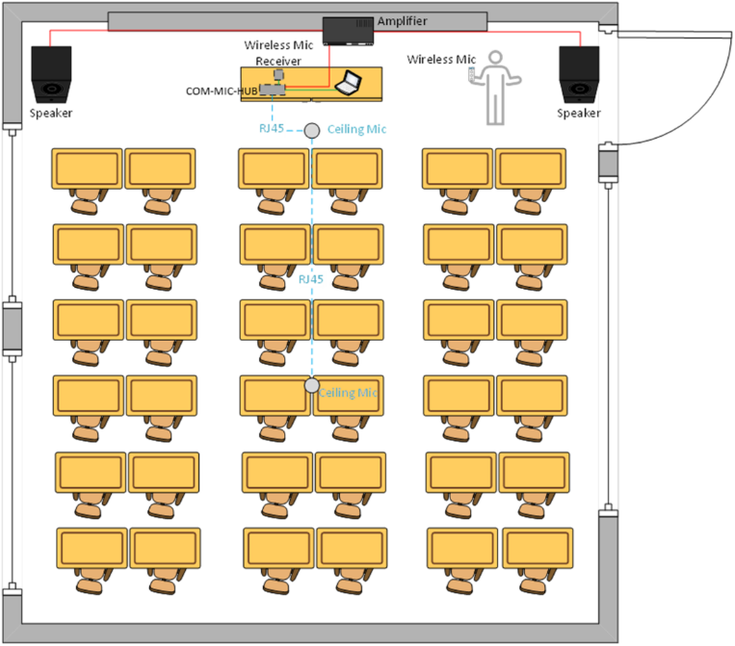
Typical Connection & Applications
The COM-MIC-HUB can be connected to APO-SKY-MIC Ceiling Microphones and 3rd party Wireless Microphones and can also be connected to PC and amplifier to provide a perfect hybrid meeting and teaching experience. Please refer to the typical connection diagram below.
Powerful · Reliable · Simple

Slide 10
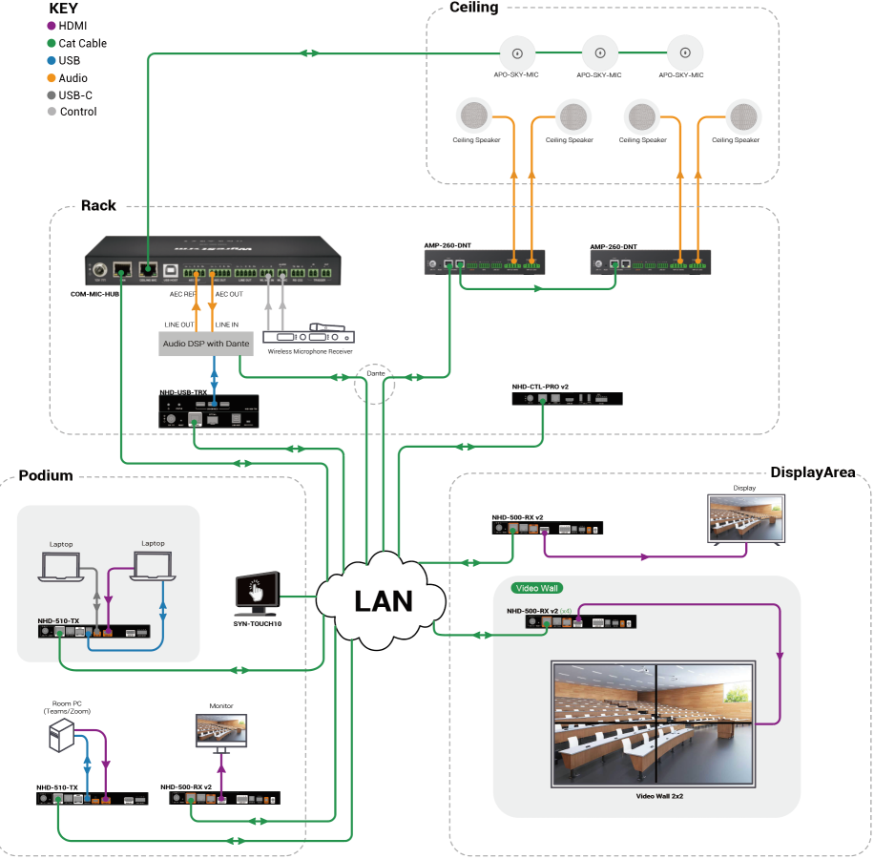
Typical Connection & Applications
Application Scenario 1: Auditorium & Lecture Hall
Perfect for auditoriums and lecture halls worked with NHD series AV over IP solution, this advanced audio system delivers seamless hybrid teaching and intuitive controls, ensuring an optimal experience for both instructors and students.
Key Benefits Include:
Hybrid application: Support local amplification and remote teaching at the same time;
Multi options for Mic: Support wireless mic and wire mic for hybrid application;
Enhance Built-in DSP: Support AEC, AGC, ANS and Ducking function, Audio Mix to provide fully immersive audio experience for all participants.
Flexible control methods: The built-in WEB UI allows both students and teachers to easily adjust settings of the COM-MIC-HUB. Additionally, partial function settings can be centrally managed through the TOUCH10 control system.
Powerful · Reliable · Simple

Slide 11
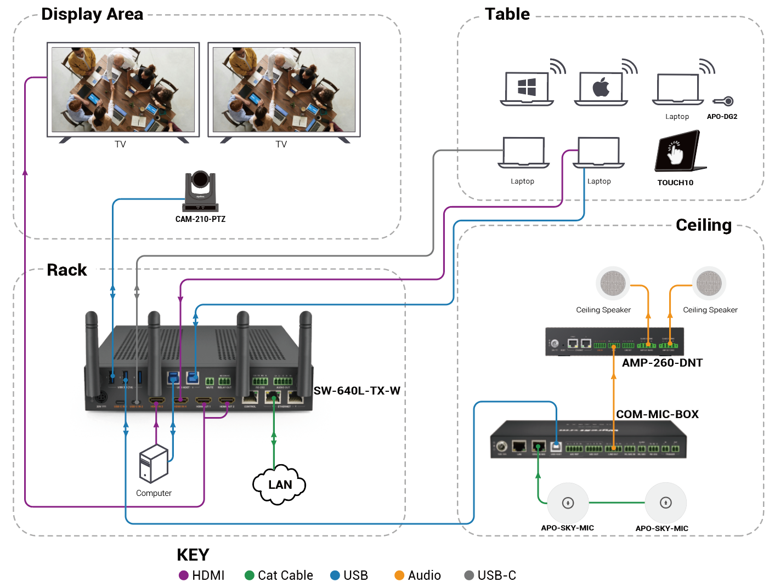
Typical Connection & Applications
Application Scenario 2 : Meeting Room
In meeting room setting, when paired with the SW-640L-TX-W, it can deliver an enhanced audio solution tailored for meeting environments. This system supports both local amplification and remote conferencing capabilities, ensuring crystal-clear audio for in-room participants as well as seamless communication with remote attendees. Whether for local discussions or virtual meetings, this setup ensures an optimal audio experience for all participants.
Key Benefits Include:
Hybrid application: Support local amplification and remote conferencing at the same time;
Enhance Built-in DSP: Support AEC, AGC, ANS and Ducking function, Audio Mix to provide fully immersive audio experience for all participants.
Flexible control methods: TOUCH10 enables centralized control of all meeting room devices, while the COM-MIC-HUB's built-in WEB UI offers simple and convenient configuration options.
Powerful · Reliable · Simple

Slide 12
Quick Installation Guide
Effortlessly set up your COM-MIC-HUB with simple steps, ensuring seamless configuration and an exceptional viewing experience.
Connect Interfaces: Follow the standard product connection guidelines and customize connections based on your environment’s layout for optimal performance.
Start the Device: Check the IP Address from the OLED Panel, then log into the Web-UI for easy equipment configuration.
Create Your Audio Processing : Create your specified configuration via Web-UI. For detailed instructions, refer to the user manual.
Enjoy Superior Audio Application: Experience stunning and immersive audio application for local amplification and remote teaching at the same time.
Powerful · Reliable · Simple

Slide 13
Important Notes for Installation
Ensure all cables are securely connected to avoid performance issues.
Check your network settings and confirm that the device is on the correct subnet.
Double-check configuration settings in the Web-UI to optimize functionality.
For complex installations, refer to the documentation or seek professional assistance if necessary.
Powerful · Reliable · Simple

Slide 14
Introduction of Web Configuration Interface
The Web UI of the COM-MIC-HUB is designed for intuitive device management and control through any web browser. With the Web UI, you can easily configure and customize your audio setup with the following features:
Web UI Functionality:
Interface: Effortlessly manage device settings via a web browser.
Setting up: Audio input and output setting and Ducking mode and parameter.
Key Web UI Configurations:
IP Settings: Configure IP settings and perform firmware updates.
S.O.S setting: Configure Alarm in mode and Message output mode.
Audio Inputs/Outputs: Configure the Audio mode and Ducking setting;
System : Device information and perform firmware updates.
Powerful · Reliable · Simple

Slide 15

Final Thoughts
Q & A Session
Got questions? Don't hesitate to ask away.
Powerful · Reliable · Simple

